Slide 1
Blood Today
A Blood Bank Management System

Slide 2
Abstract
Blood Bank Management System is a Web based application that is designed to store, process, retrieve, deliver and analyze information concerned within a blood bank.
This project aims at maintaining all the information pertaining to blood donors, different blood groups available in each blood bank and help them manage in a better way.
Project Aim is to provide transparency in this field, make the process of obtaining blood from a blood bank hassle free and corruption free and make the system of blood bank management effective.

Slide 3
Users
Admin : All privileges and accessibility. Adding new blood Banks and Hospital
Blood Bank : Accept Blood request and Donors appointments. Deliver blood and conduct blood donation camps.
Hospital : Request necessary blood for patients.
Donor : Request appointment and donate blood.
Free user : Free to visit website and view donors list ,blood stock and new blood requests

Slide 4
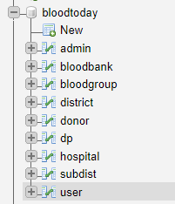
Database Tables

Slide 5
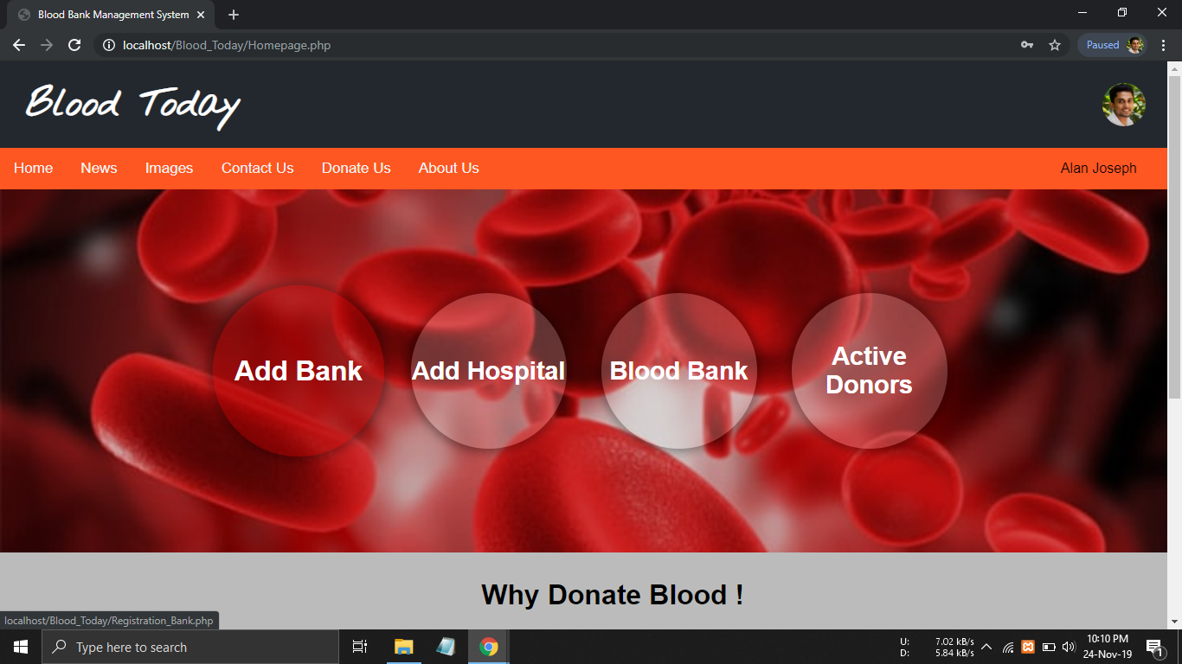
Admin

Slide 6
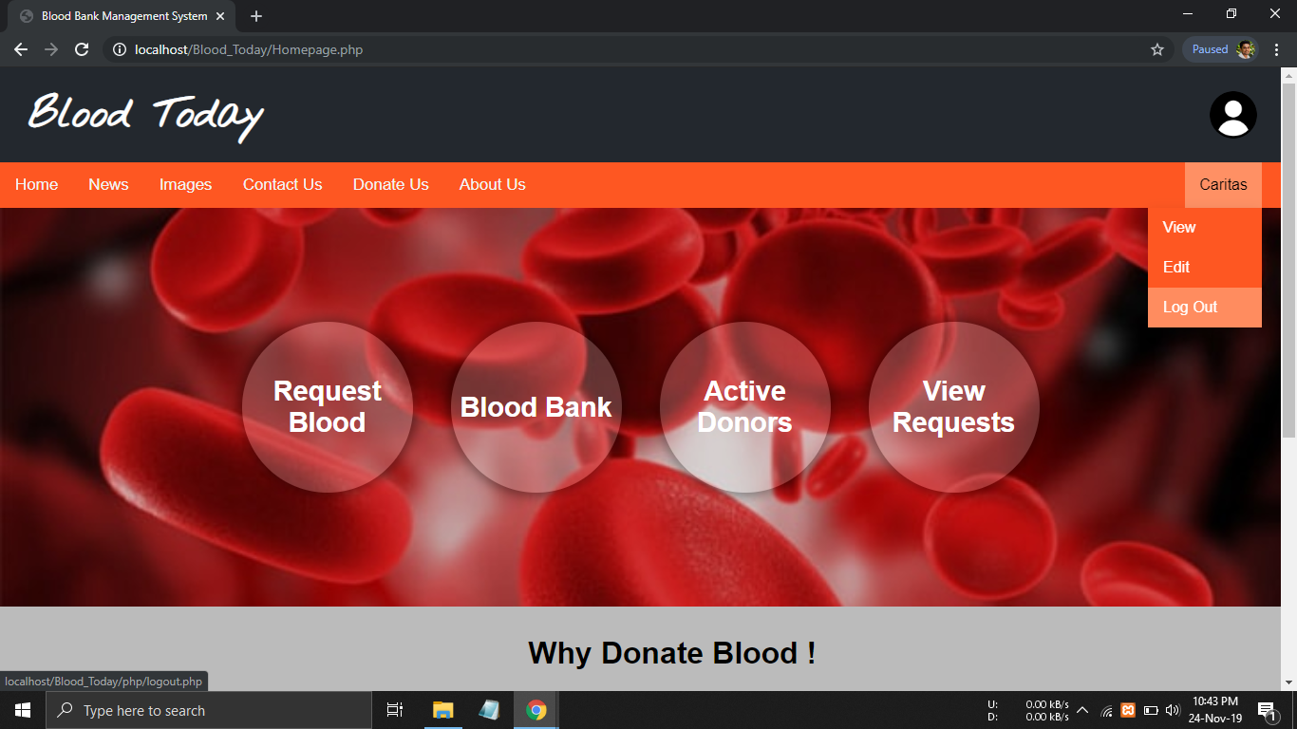
Hospital

Slide 7
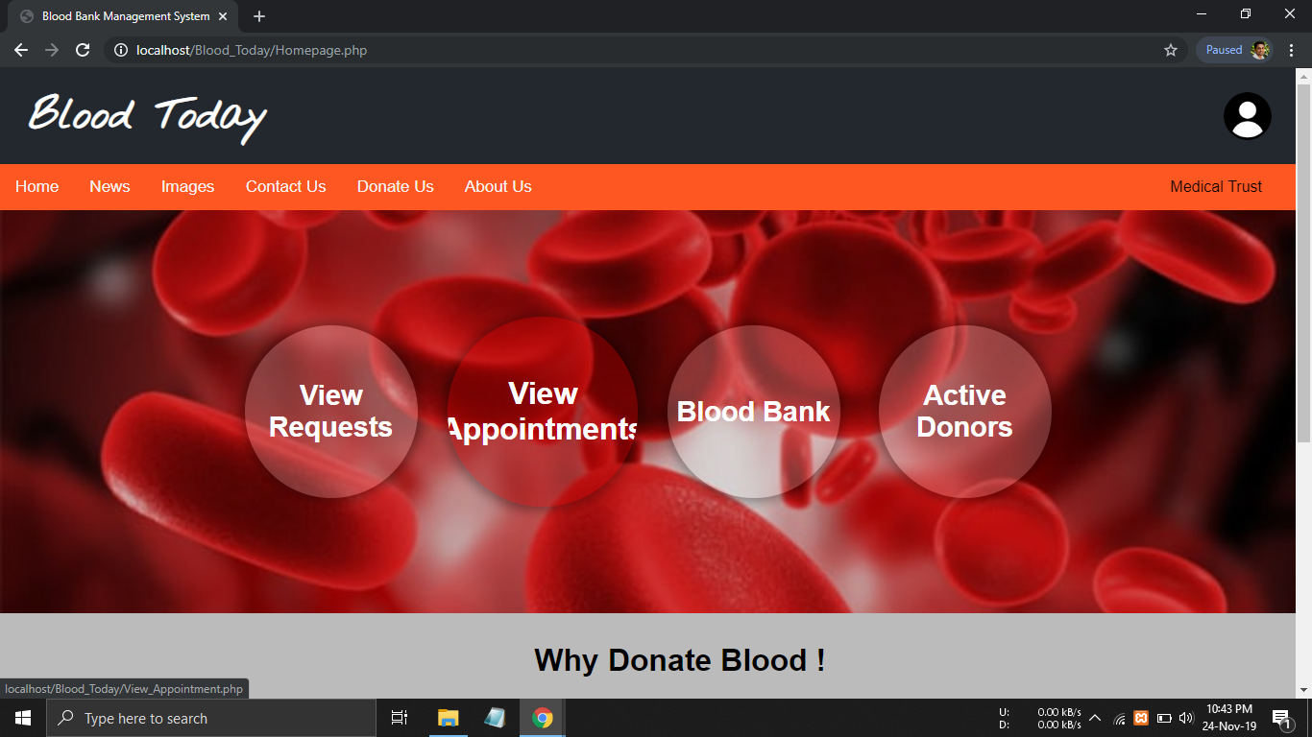
Blood Bank

Slide 8
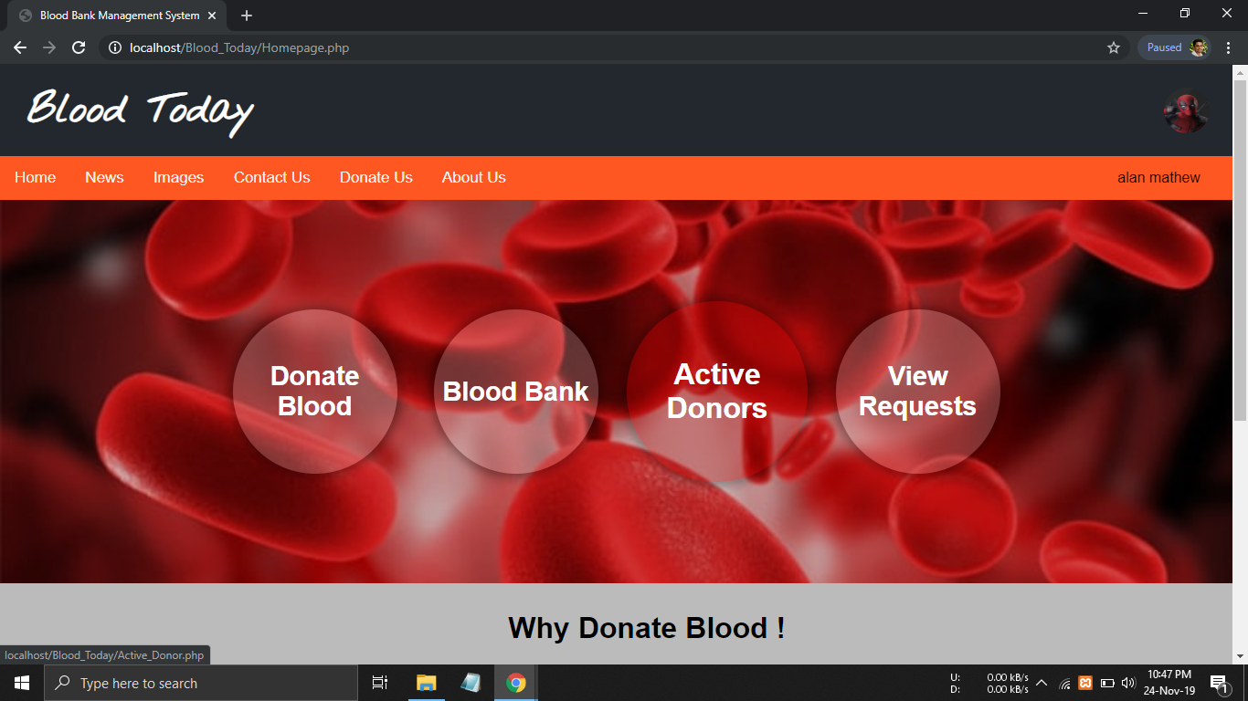
Donor

Slide 9
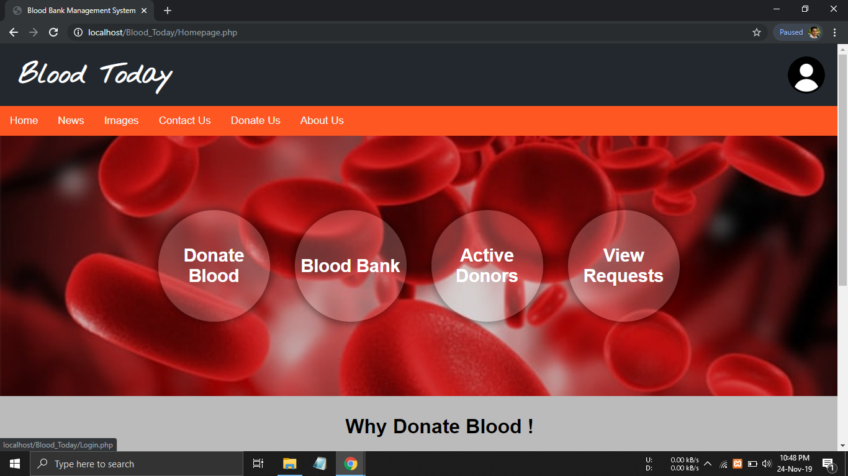
Free User

Slide 10
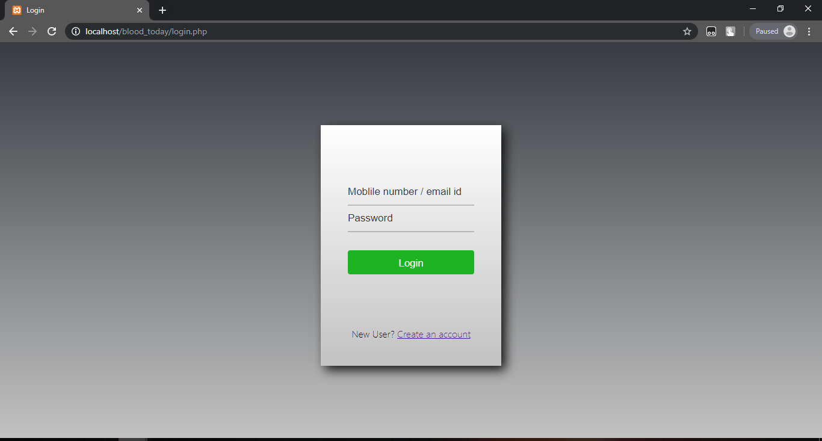
Login:

Slide 11
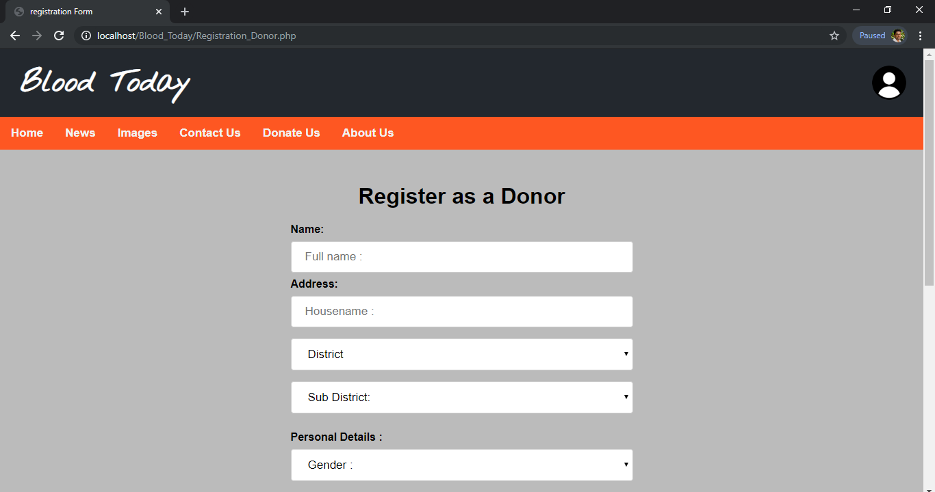
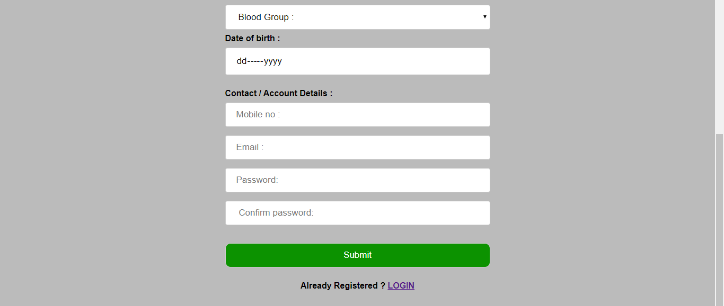
Registration:

Slide 12
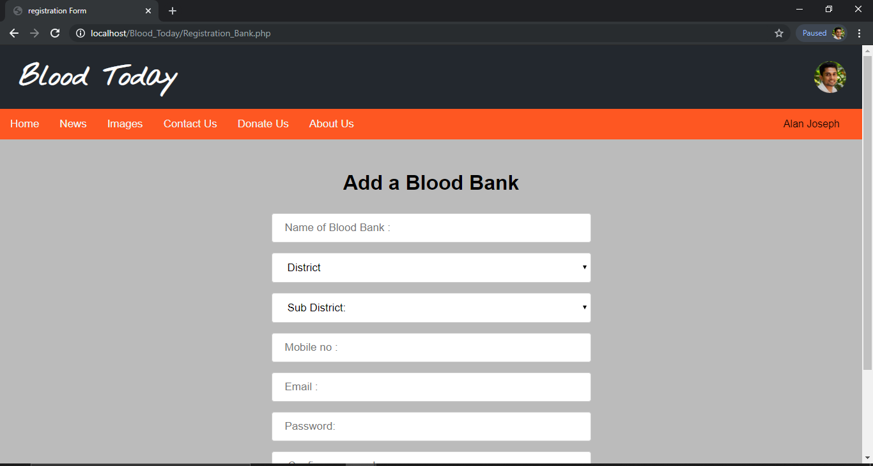
Registration:

Slide 13
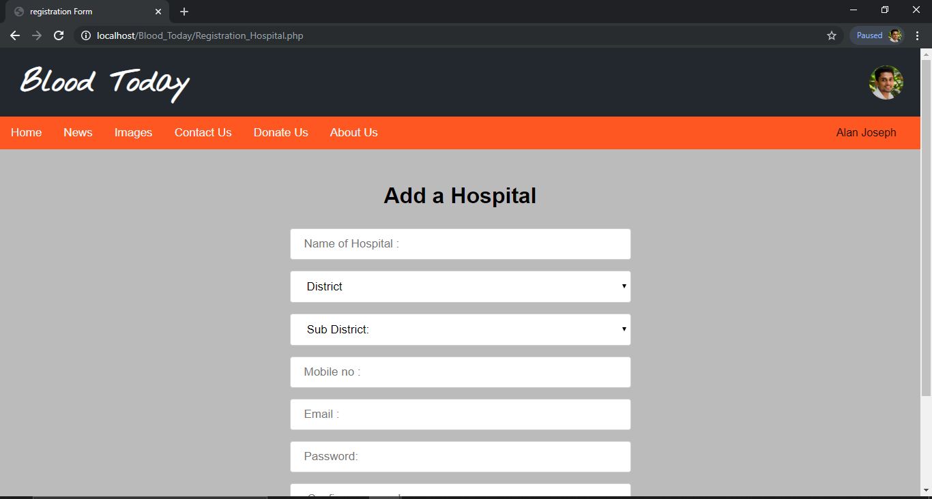
Registration:

Slide 14
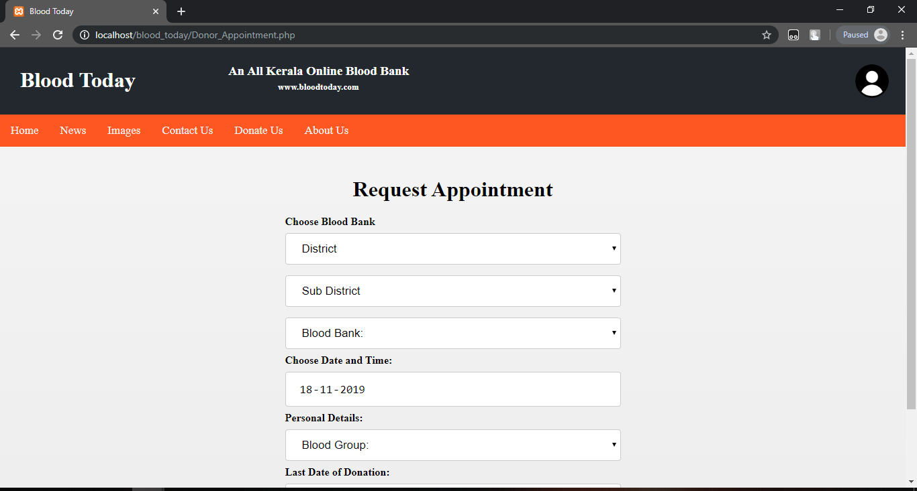
Request Appointment:

Slide 15
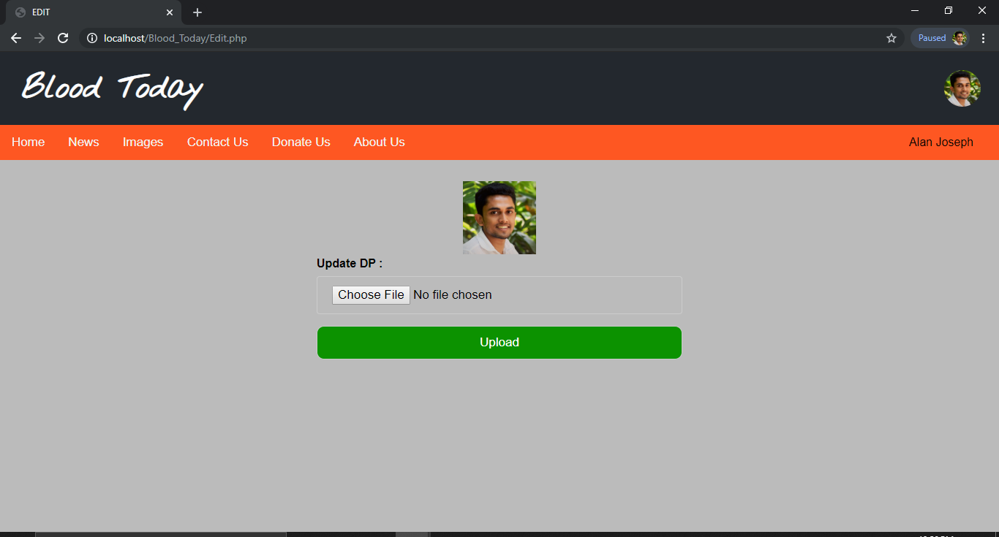
Uploading file:

Slide 16
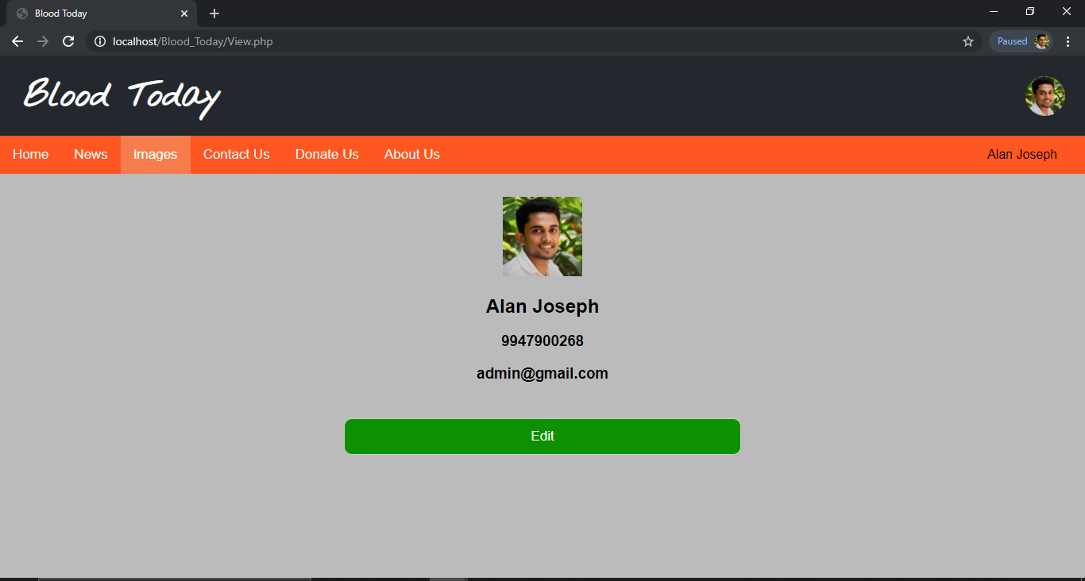
View profile:

Slide 17
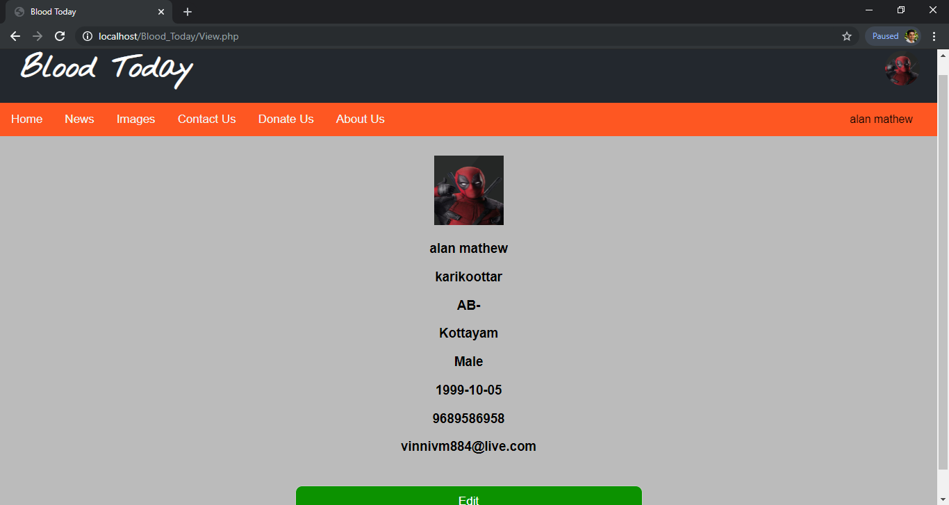
View profile:

